Slide 1
Book Recommendation System

Slide 2
Sprint 2
Project Description
Problem Statement
Implementation of the Project

Slide 3
A recommendation system helps an organization to create loyal customers and build trust by them desired products and services for which they came on your site. The recommendation system today are so powerful that they can handle the new customer too who has visited the site for the first time. They recommend the products which are currently trending or highly rated and they can also recommend the products which bring maximum profit to the company
Project Description

Slide 4
Problem Statement
Goal: Design book recommendation system by several methods and explore the strengths and weaknesses of each method.
Research Question:
How can we calculate the similarity between books based on their content? How can we apply it to a recommendation system?
How can we predict the rating that a user will give to books that they haven't read? How can we apply it to a recommendation system?
What are the strengths and weakness of each method? How to overcome the weakness?

Slide 5
Importing Dataset
Import Dataset
In this project, we will use Goodreads dataset. This dataset consist of 5 files which are:
ratings.csv: contains user ratings for books they read
books_enriched.csv: contains metadata for each book (book ID, title, authors, year published, etc)
to-read.csv: contains books marked "to read" by users
book_tag.csv: contains tags/shelves/genres assigned by users to books
tag.csv: contains the tag names corresponding to the tag ids in book_tag.csv

Slide 6
Data Modeling
Now, it's time to develop recommendation systems. In this notebook, the recommendation systems developed based on several methods:
Basic Recommender
Content-based Filtering
Collaborative Filtering

Slide 7
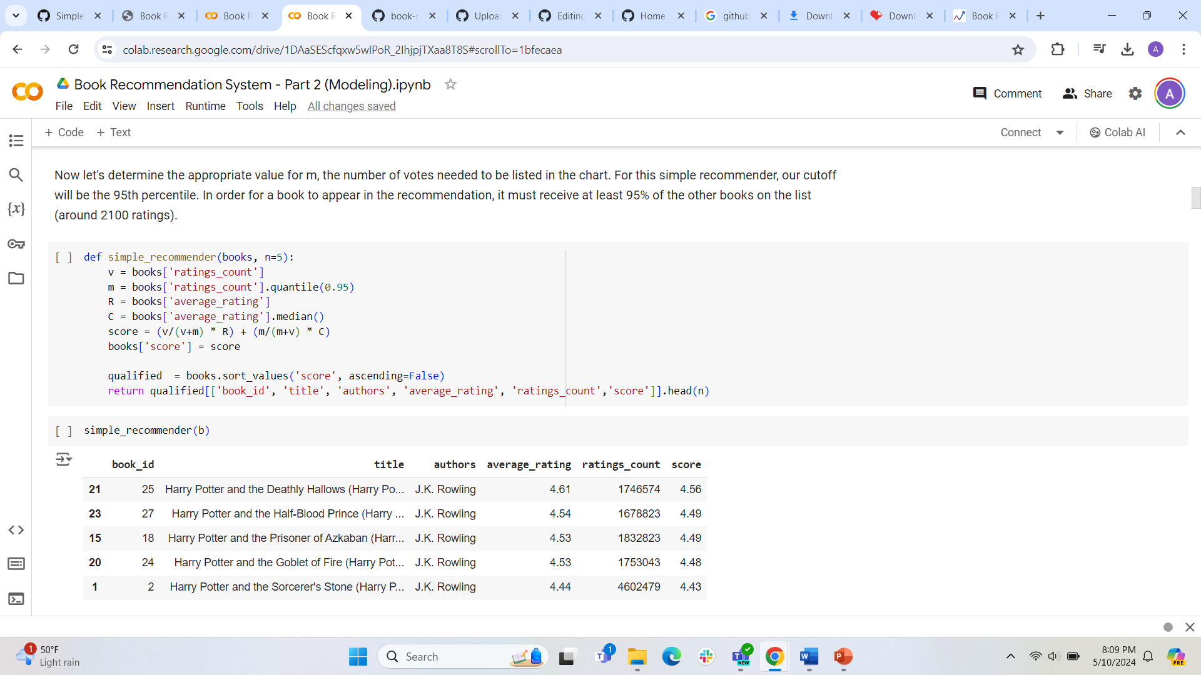
Recommendation based on Weighted Average of Rating and Popularity

Slide 8
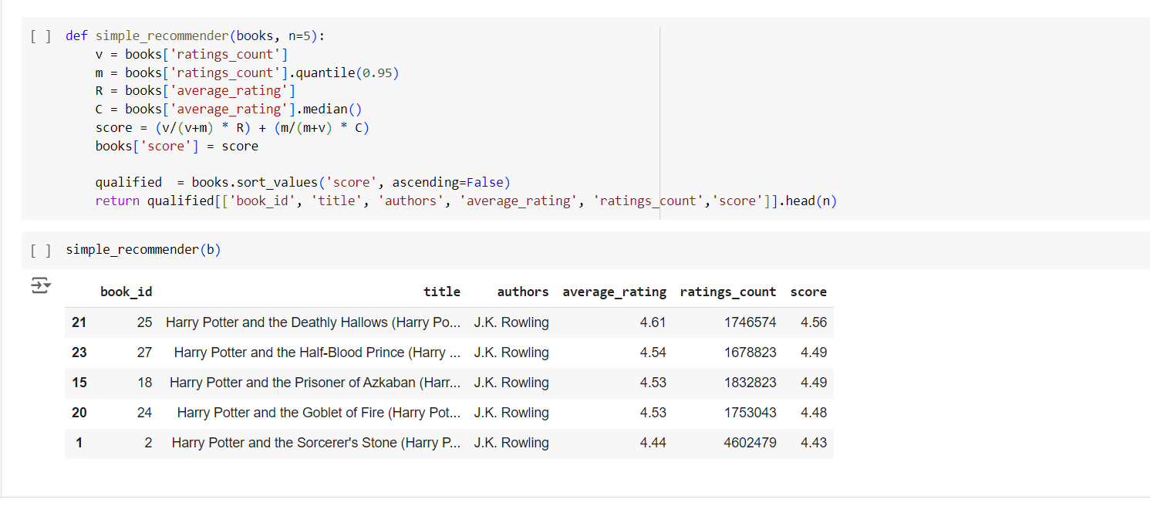
Simple Recommender

Slide 9
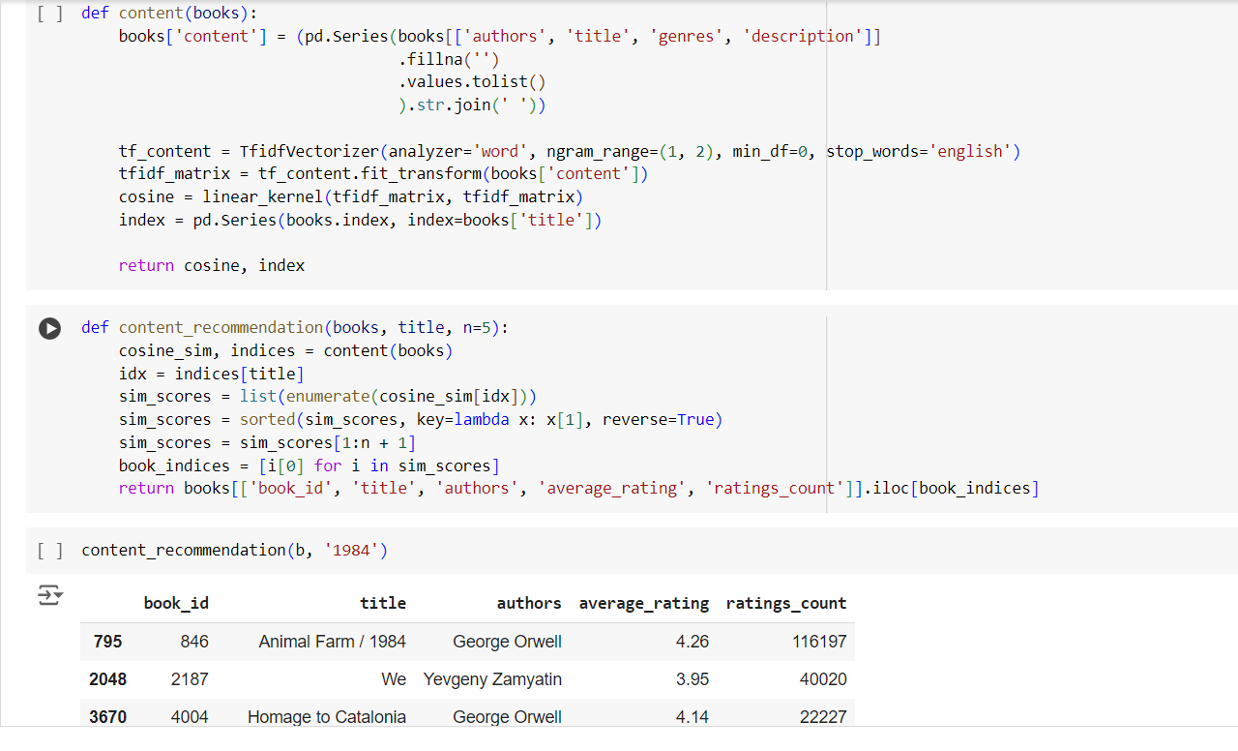
Content Based Recommender

Slide 10
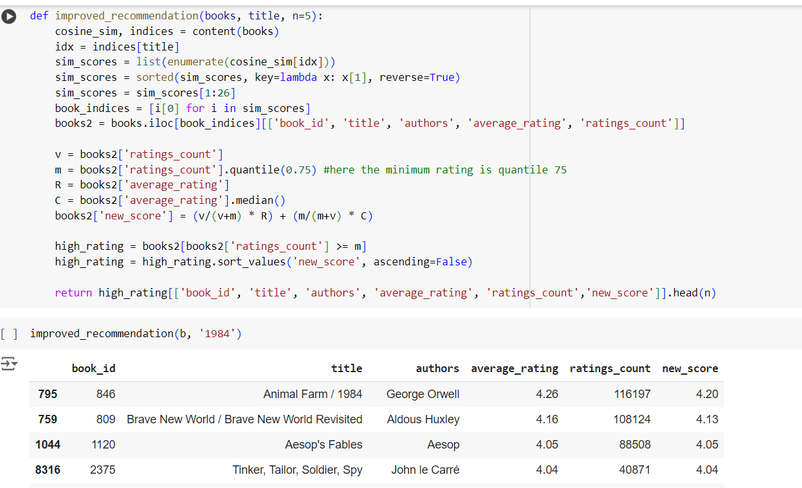
Content Based + Popularity-Rating Filter

Slide 11
Collaborative Filtering
This system suggests book to users based on past reading history and collaboration of other users' preferences. This recommender systems provides personalized recommendation. In this notebook, I will use Surprise library to make the recommendation system. Surprise is a Python scikit for building and analyzing recommender systems that deal with explicit rating data. I will try to fit into 4 model and evaluate by using RMSE value.
1.Normal Predictor
KNN (Memory-based)
SVD (Model-based)
SVD++ (Model-based)

Slide 12
Conclusion
Simple Recommender This model offers the simple recommendation. This model does not provide user-specific recommendations but suitable for new user (have no cold-start problem). Cold problem refers to a problem when the system is unable to draw any conclusions about users or objects because it has not yet acquired enough data.
Content based filtering Recommendations based on title, authors, description, and genre using cosine similarity have been made. To provide a balance of book recommendations, an additional popularity-rating filter has been added. This method is suitable for people who are looking for books that are like their favorite books, but this system cannot capture tastes and provide recommendations across genres.
Collaborative Filtering By using Surprise library, I tried building a recommender with 4 algorithms: Normal Predictor, KNN, SVD, and SVD++. SVD is suitable for making a recommendation system in Goodreads because of its lower RMSE, faster calculation and lower memory requirement unlike KNN.

